Slide 1


Steshi
18 April 2024

Slide 2
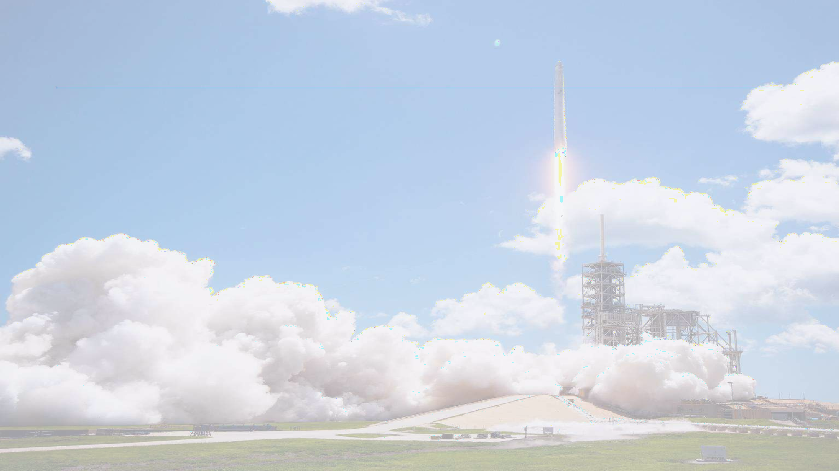
Outline
Executive Summary
Introduction
Methodology
Results
Conclusion
Appendix
2

Slide 3

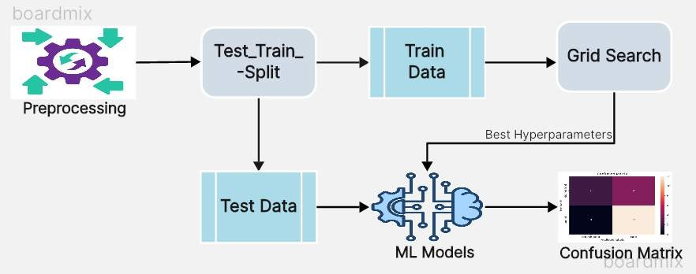

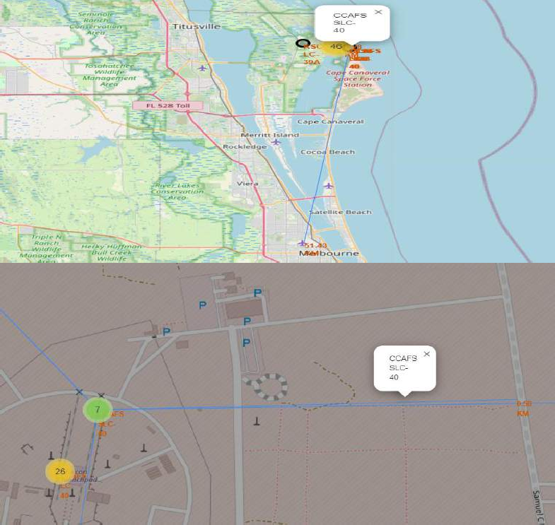
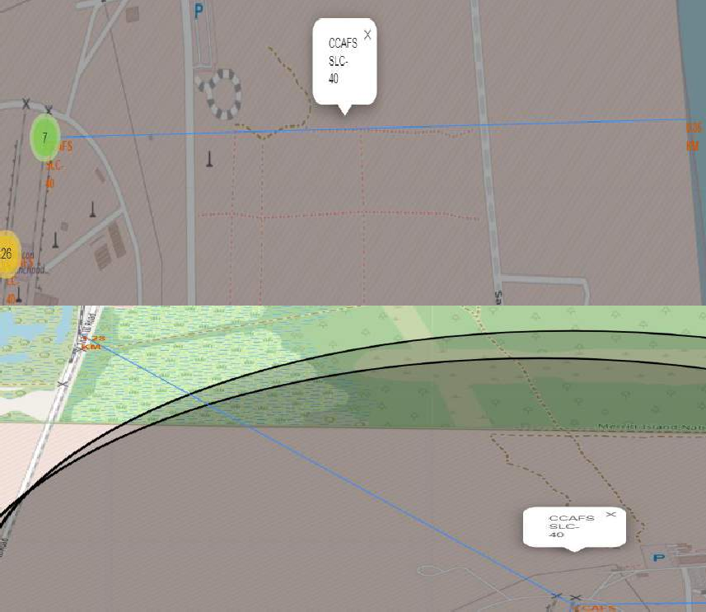

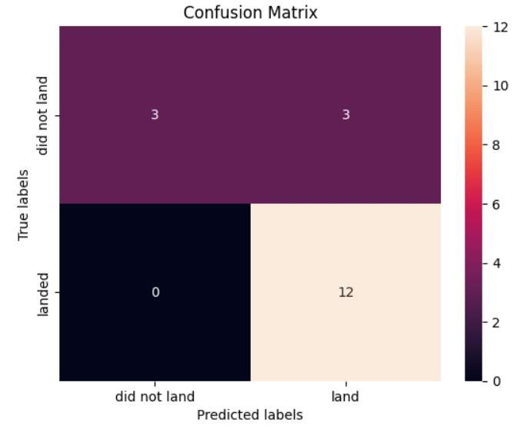
Executive Summary
Summary of methodologies
Data Collection through API
Data Collection with Web Scraping
Data Wrangling
Exploratory Data Analysis with SQL
Exploratory Data Analysis with Data Visualization
Interactive Visual Analytics with Folium
Machine Learning Prediction
Distance to closest City
Distance to Coastline
Distance to closest Highway
Distance to closest Railroad
Summary of all results
Exploratory Data Analysis result
Interactive analytics in screenshots
Predictive Analytics result
3

Slide 4

Introduction
The commercial space age has arrived, with companies making space travel more accessible than ever. Among them, SpaceX stands out, promoting Falcon 9 rocket launches at a significantly lower cost than competitors, thanks to its innovative approach to reusing the first stage.
In this capstone, we embark on a journey to predict the success of Falcon 9 first stage landings using advanced Machine Learning models. We aim to provide valuable insights for cost estimation in the fiercely competitive space launch industry by:
Utilizing advanced Machine Learning models to predict the success of Falcon 9 first stage landings.
Identifying and analyzing key factors that influence the success of Falcon 9 first stage landings.
Providing valuable insights into the space launch industry by understanding the relationship between various factors and landing success.
4

Slide 5

Section 1
5

Slide 6
Methodology
Executive Summary
Data collection methodology:
Data Collection has been performed using SpaceX REST API and Web Scraping related wiki pages.
Perform data wrangling
Transitioned Landing Outcomes to classes 1(Successful landing) and 0(Unsuccessful Landing).
Perform exploratory data analysis (EDA) :
Derived insights using visualization and SQL.
Perform interactive visual analytics :
Used Folium and Plotly Dash to perform visual analysis.
Perform predictive analysis using classification models
Used models like SVM , Logistic Regression , KNN , etc. along with GridSearchCV to find the best
parameters for creating the models.
6

Slide 7
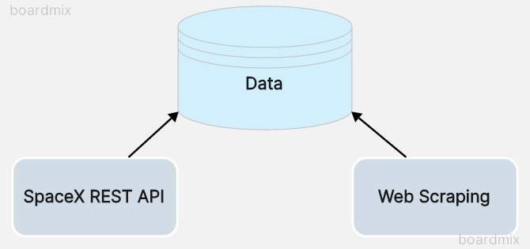
Data Collection
In the data collection methodology, two robust sources are integrated: the SpaceX API and Web Scraping techniques.
Through the SpaceX API, structured data is accessed directly from SpaceX's servers, ensuring reliability and accuracy.
Additionally, web scraping is employed to extract valuable insights from relevant web pages, enriching the dataset with comprehensive information.

Slide 8
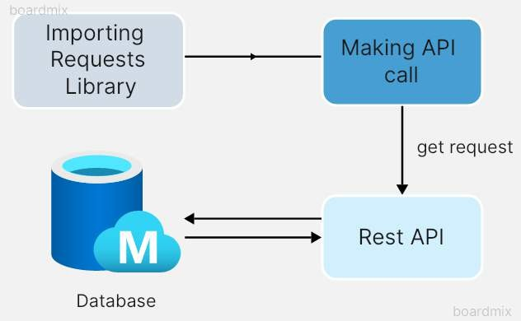
Data Collection – SpaceX API
In this section, we'll utilize a targeted API endpoint to obtain historical launch data vital for our analysis.The following are the key steps:
Targeted API Endpoint: Utilizing a specific URL to access the desired data endpoint.
GET Request Execution: Employing the requests library to execute a GET request, ensuring seamless data retrieval.
JSON Transformation: Converting the retrieved response into a JSON format, facilitating easy interpretation and manipulation.
GitHub URL of the related notebook: https://github.com/Steshitaya28/SpaceX-Data-Collection-using-API

Slide 9
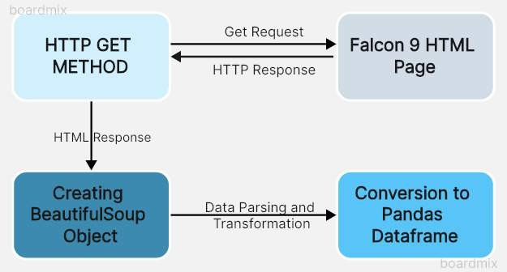
Data Collection - Scraping
In this segment, we'll employ Python's BeautifulSoup library to scrape HTML tables containing Falcon 9 launch
records.Following are the key objectives:
Web Scraping with BeautifulSoup: Leveraging BeautifulSoup to extract data from HTML tables containing Falcon 9 launch records.
Data Parsing and Transformation: Parsing the scraped data and converting it into a structured format suitable for further analysis.
Creating a Clean Dataset: Converting the parsed data into a Pandas DataFrame.
GitHub URL of the related notebook:
https://github.com/Steshitaya28/SpaceX-Applied-Data-Science-Capstone/blob/main/SpaceX-Data-
Collection-using-WebScraping.ipynb
9

Slide 10

Data Wrangling
During the data wrangling phase, we performed the following tasks:
Checked the dataset for null values to ensure data integrity.
Verified the correct data types for all features in the dataset.
Calculated the frequency of launches on each site to understand launch distribution.
Determined the occurrences of orbits to gain insights into mission destinations.
Converted various landing outcomes into binary values, assigning 0 for unsuccessful landings and 1 for successful ones, thereby creating a classification variable.
GitHub URL of the related notebook:
https://github.com/Steshitaya28/SpaceX-Applied-Data-Science- Capstone/blob/main/Data-Wrangling-of-SpaceX-Dataset.ipyn₁b₀

Slide 11
EDA with Data Visualization
During our exploratory data analysis, enhanced by visualizations, we undertook the following tasks:
Scatter Plots: Examined relationships between flight number, payload, launch site, and orbit using scatter plots to assess their impact on success rate.
Bar Chart: Created a bar chart to compare success rates for each orbit, aiming to uncover
associations.
Line Chart: Plotted a line chart showing success rates over the years, offering insight into their evolution.
One-Hot Encoding: Implemented one-hot encoding on features, converting categorical
variables into numerical representations for analysis.
GitHub URL of the related notebook:
https://github.com/Steshitaya28/EDA-of-SpaceX-Dataset-with-Visualization

Slide 12
EDA with SQL
The SpaceX dataset was imported into a PostgreSQL database directly within the Jupyter Notebook environment.
Exploratory data analysis (EDA) was then carried out using SQL to extract insights from the dataset. Queries were formulated to uncover:
The names of different launch sites involved in the space mission.
The total payload mass carried by boosters launched by NASA's Commercial Resupply Services (CRS).
The average payload mass carried by booster version F9 v1.1.
The total number of successful and failed mission outcomes.
Details on failed landing outcomes on drone ships, including their booster version and launch site names.
GitHub URL of the related notebook:
https://github.com/Steshitaya28/EDA-of-SpaceX-Dataset-using-SQL

Slide 13
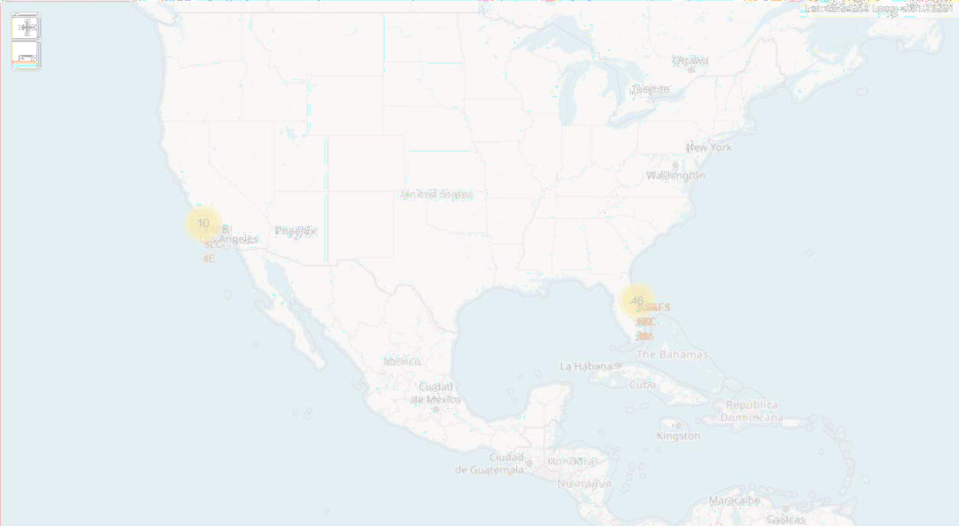
Build an Interactive Map with Folium
All launch sites were carefully marked on the map, with markers, circles, and lines used to indicate the success or failure of launches for each site in the Folium map.
Launch outcomes were categorized into two groups: 0 for failure and 1 for success.
Color-coded marker clusters helped us identify launch sites with higher success rates.
Additionally, we calculated the distances between each launch site and nearby features. We explored questions such as:
How close are launch sites to railways, highways, and coastlines?
Do launch sites maintain a certain distance from cities?
GitHub URL of the related notebook:
https://github.com/Steshitaya28/SpaceX-Interactive-Visual-Analytics-with-Folium

Slide 14

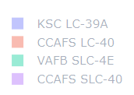
Build a Dashboard with Plotly Dash
In this section , we performed the following tasks:
We assessed four launch sites to identify the one with the highest success count.
A dropdown menu was created to select specific launch sites.
A callback function rendered a success pie chart based on the selected site.
We investigated the correlation between payload and mission outcome.
To analyze visual patterns, a range slider facilitated the selection of payload values.
An additional callback function was implemented to render a success-payload scatter chart,
shedding light on the payload's influence on mission success.
GitHub URL of the related notebook:
https://github.com/Steshitaya28/SpaceX-Interactive-Dashboard-using-Plotly-Dash

Slide 15
Predictive Analysis (Classification)
Data preprocessing
standardized the data.
Train_test_split divided the data into training and testing sets.
We trained the models (Logistic Regression, Support Vector Machines, Decision Tree Classifier, and
K-nearest Neighbors) and conducted Grid Search to find optimal hyperparameters for each
algorithm.
Using the best hyperparameter values, we determined the model with the highest accuracy
on the training data.
Finally, we generated and analyzed the confusion matrix.
GitHub URL of the related notebook:
https://github.com/Steshitaya28/SpaceX-Applied-Data-Science-Capstone/blob/main/SpaceX-
Machine-Learning-Prediction.ipynb
15

Slide 16
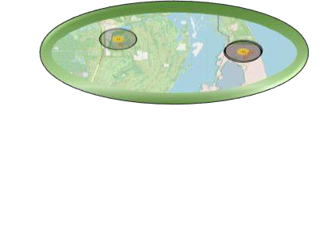

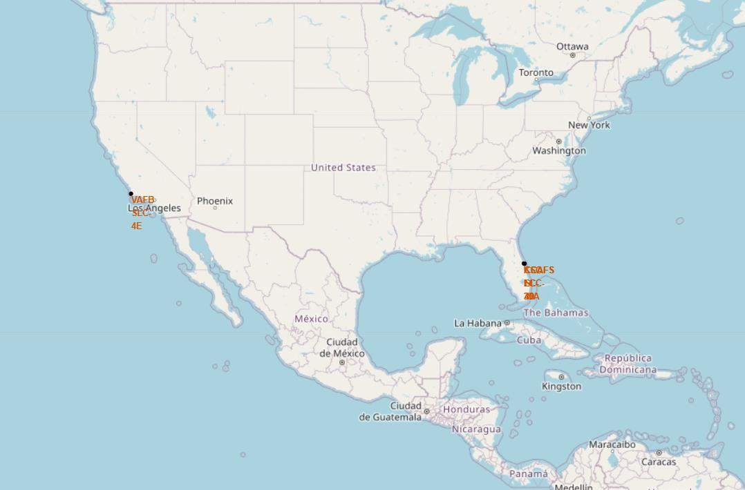
Results
Exploratory data analysis results:
Heavy Payloads are associated with higher frequency of successful landings.
Orbits ES-L1, GEO, HEO and SSO demonstrate the highest success rates.
There is a Positive correlation between the number of flights conducted at a launch site and the success rate of launches at that site.
The success rate has been on a steady rise since 2013, with the exception of a noticeable drop in 2018.
The first successful landing on a ground pad occurred on December 22, 2015.
Interactive analytics results and demo:
The launch sites are located along the coasts of the United States, specifically in California and Florida.
The launch site KSC LC-39A has the highest number of successful launches, while launch site CCAFS SLC-40 has the fewest successful launches.
Predictive analysis results:
The logistic regression model exhibits the highest accuracy (0.833), while the k- nearest neighbors (KNN) model demonstrates the lowest accuracy(0.611).
16

Slide 17

Section 2

Slide 18
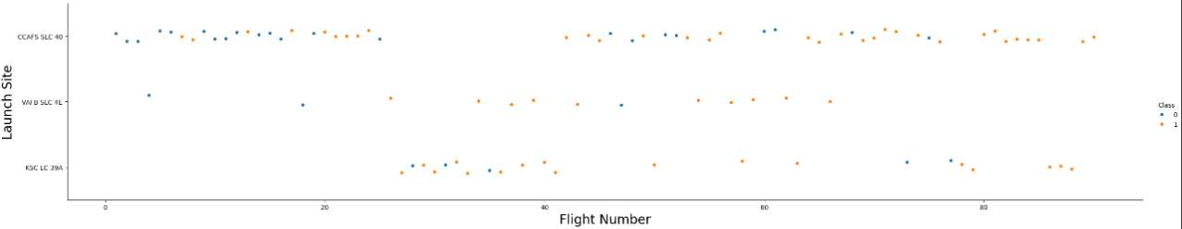
Flight Number vs. Launch Site
Based on the plot analysis, it appears that there is a positive correlation between the number of
flights conducted at a launch site and the success rate of launches at that site.

Slide 19
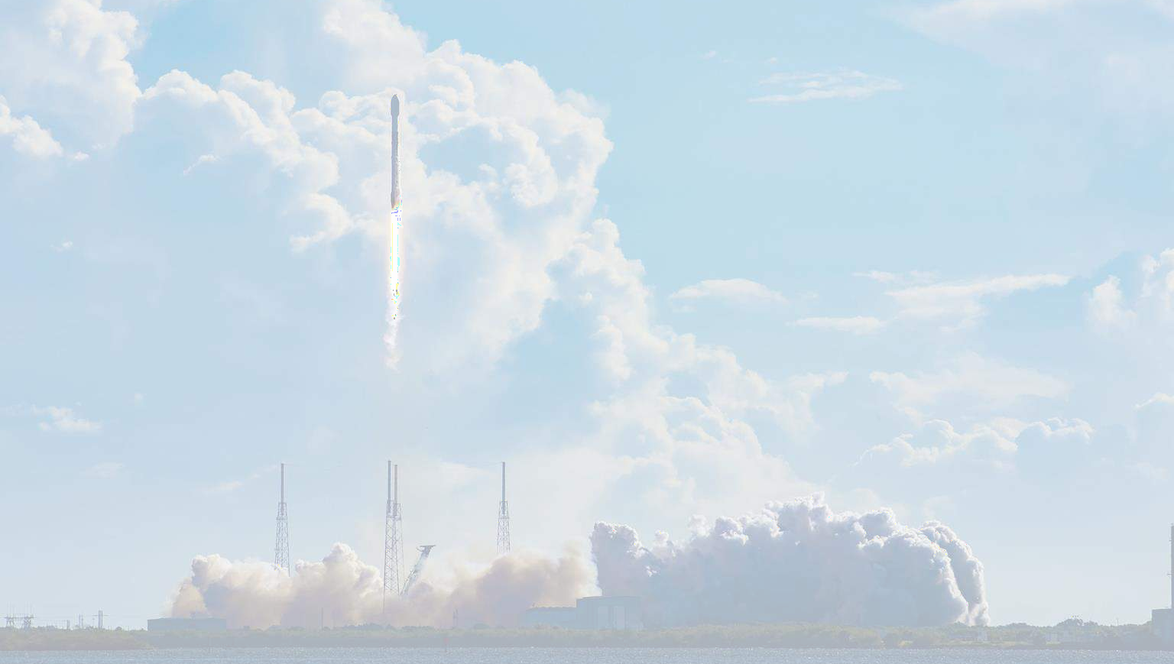
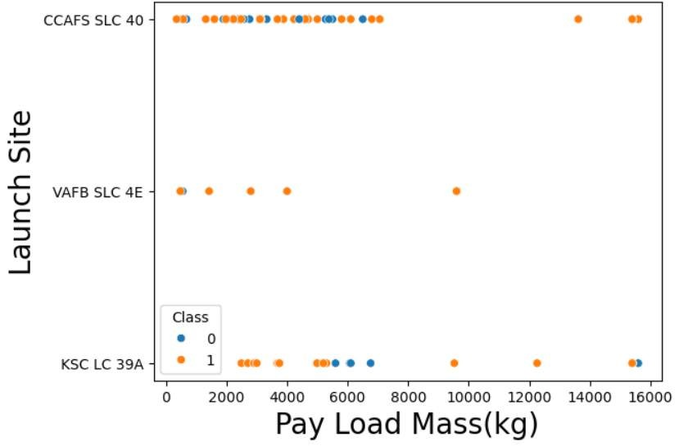
Payload vs. Launch Site
Upon examining the plot, it becomes evident that as the payload mass increases, so does the likelihood of a successful launch from the CCAFS SLC 40 site.

Slide 20
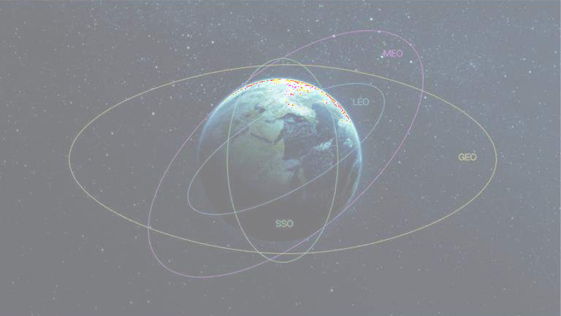
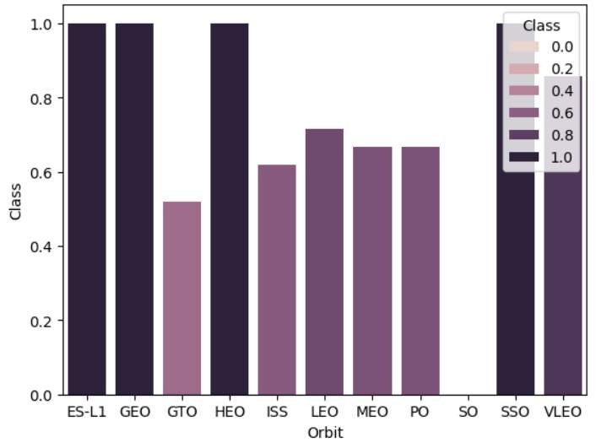
Success Rate vs. Orbit Type
The data clearly indicates that orbits ES-L1, GEO, HEO and SSO demonstrate the highest success rates, while the GTO orbit exhibits the lowest success rate among them.

Slide 21
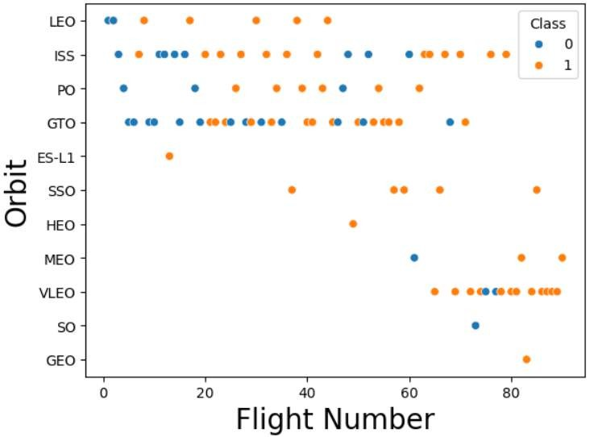

Flight Number vs. Orbit Type
The success rate of launches into GTO orbit appears to be unrelated to the flight number.
In contrast, for orbits such as LEO and MEO, there is a noticeable trend of increasing success rates with higher flight numbers

Slide 22
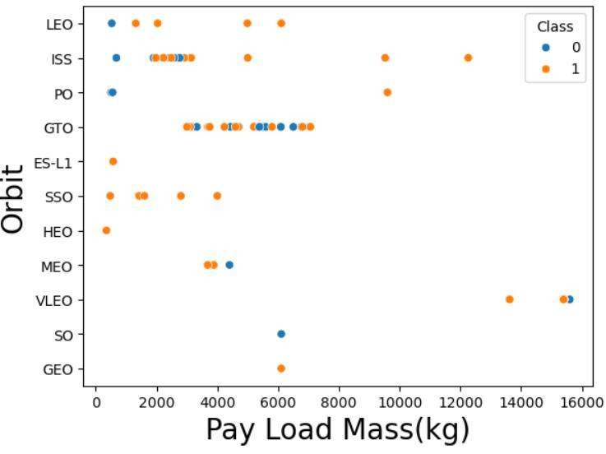
Payload vs. Orbit Type
It's evident from our observation that heavier payloads are associated with a higher frequency of successful landings in PO, LEO, and ISS orbits.

Slide 23

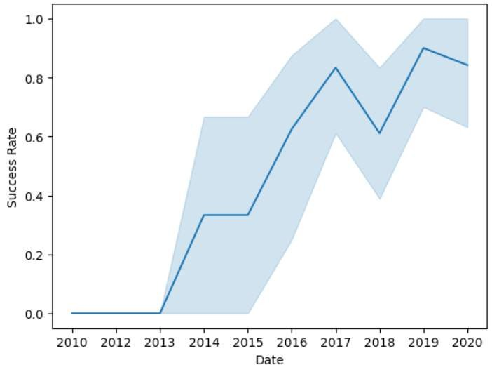
Launch Success Yearly Trend
From the data depicted in the plot, it's apparent that the success rate has been on a steady rise since 2013, with the exception of a noticeable drop in 2018.

Slide 24

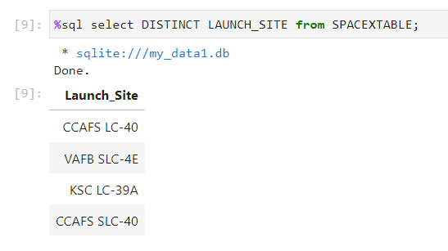
All Launch Site Names
We used the DISTINCT keyword to eliminate duplicate entries and focus solely on distinct launch site names stored within the SPACEXTABLE.

Slide 25

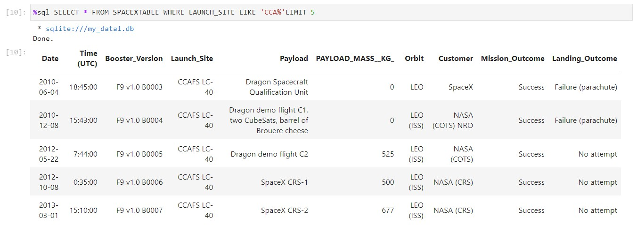
Launch Site Names Begin with 'CCA'
We utilized the keywords LIKE and LIMIT to filter and display only the first five records from the database where the launch site name begins with “CCA“.

Slide 26

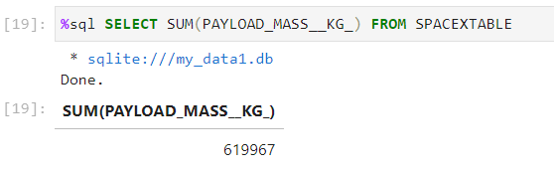
Total Payload Mass
The aggregate function SUM was used to calculate the total payload carried by boosters from NASA.

Slide 27

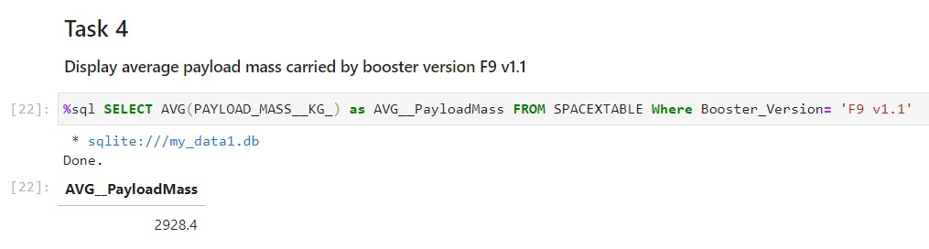
Average Payload Mass by F9 v1.1
We utilized the aggregate function AVG with a suitable predicate in the WHERE clause to calculate the average payload mass carried by booster version F9 v1.1.

Slide 28

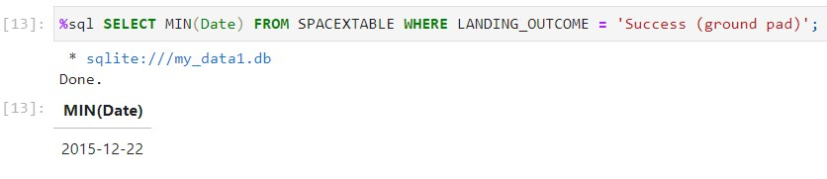
First Successful Ground Landing Date
It was observed that the first successful landing on a ground pad occurred on December 22, 2015.

Slide 29

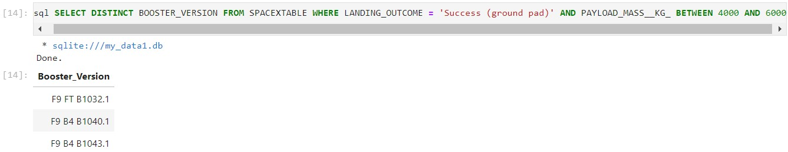
Successful Drone Ship Landing with Payload between 4000 and 6000
We employed the WHERE clause to filter for boosters that have achieved successful landings on drone ships. Additionally, we utilized the BETWEEN operator, along with the AND operator, to specify successful landings with a payload mass greater than 4000 but less than 6000.

Slide 30

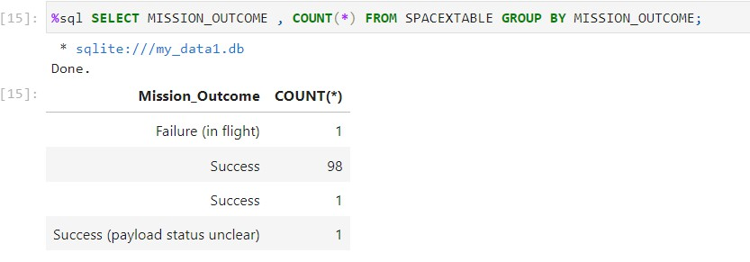
Total Number of Successful and Failure Mission Outcomes
We employed the COUNT function extensively to compute the total number of successful and unsuccessful landings.

Slide 31

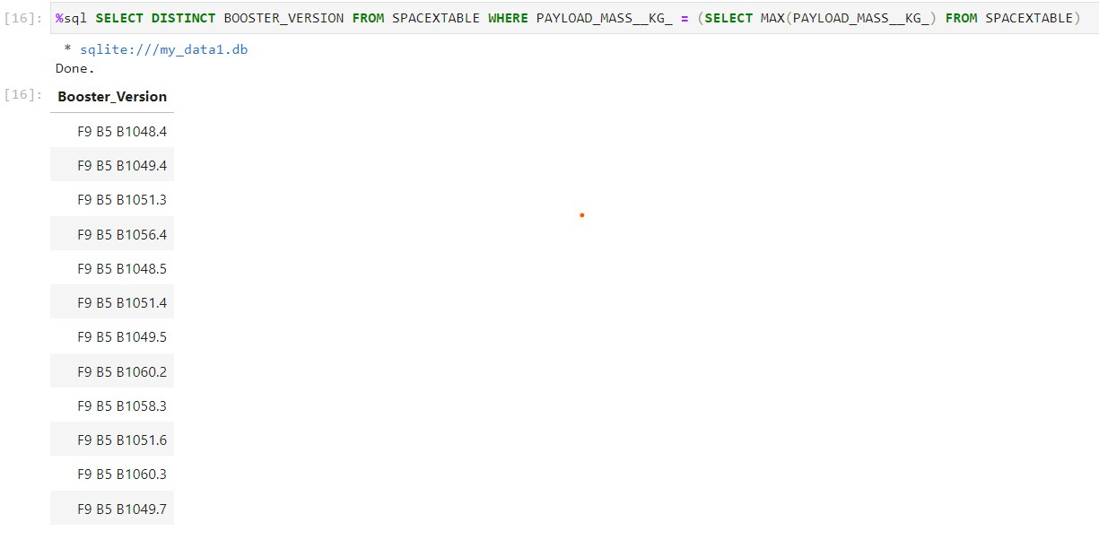
Boosters Carried Maximum Payload
We employed a subquery within the WHERE clause alongside the MAX()
function to determine the boosters that have carried the maximum payload.

Slide 32

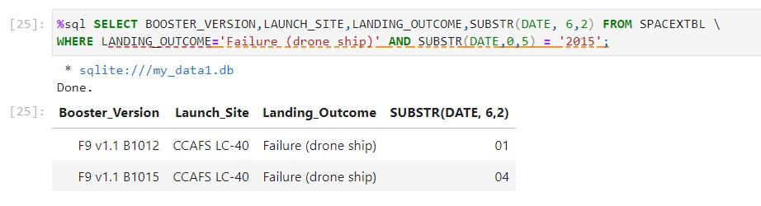
2015 Launch Records
We employed a combination of conditions using the WHERE clause, including AND and SUBSTR, to filter for failed landing outcomes on drone ships, along with their corresponding booster versions and launch site names for the year 2015.

Slide 33

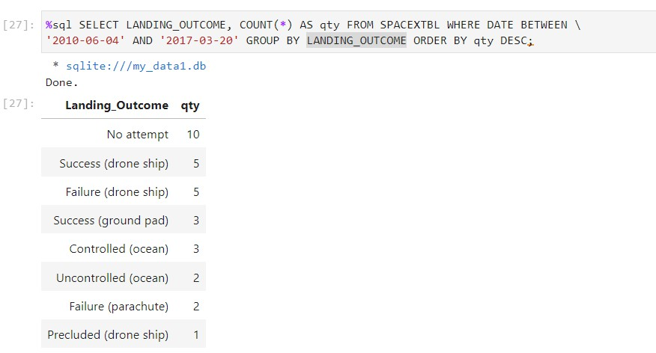
Rank Landing Outcomes Between 2010-06-04 and 2017-03-20
We selected landing outcomes and their corresponding counts from the dataset, using the WHERE clause with BETWEEN AND to filter for landing outcomes between June 4, 2010, and March 20, 2010.
Then, we applied the GROUP BY clause to group the landing outcomes and the ORDER BY clause to arrange the grouped landing outcomes in descending order.

Slide 34

Section 3

Slide 35
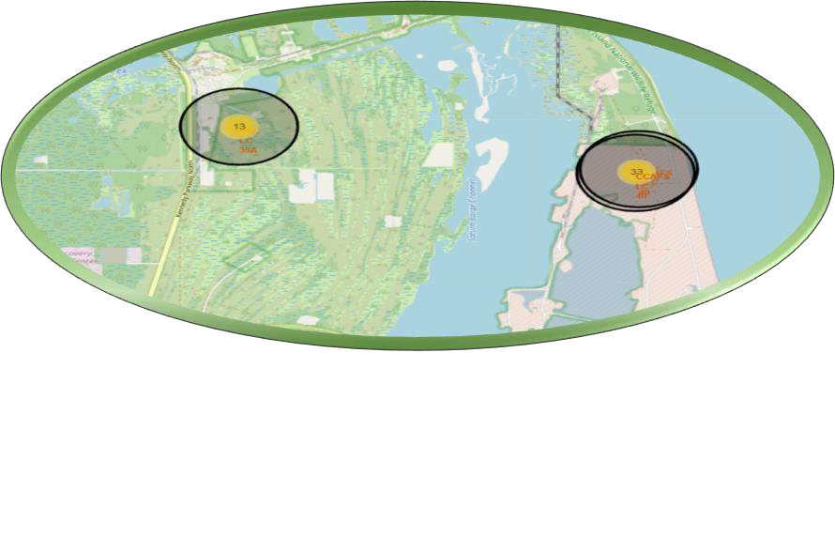

All Launch Sites Global Map Markers
As observed from the map ,the launch sites are located along the coasts of the
United States, specifically in California and Florida.

Slide 36
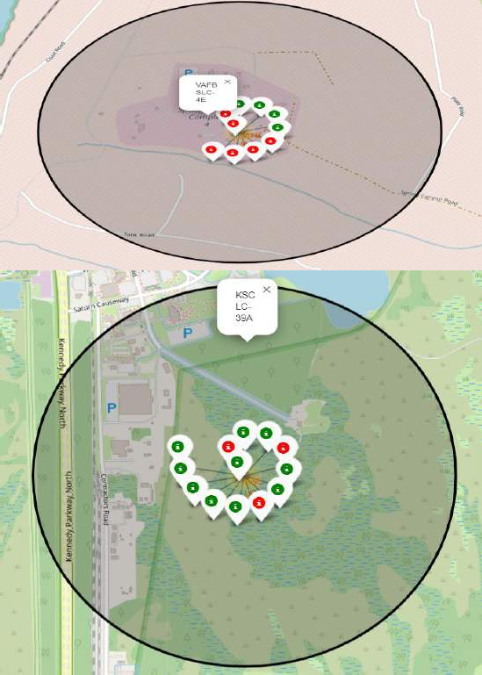

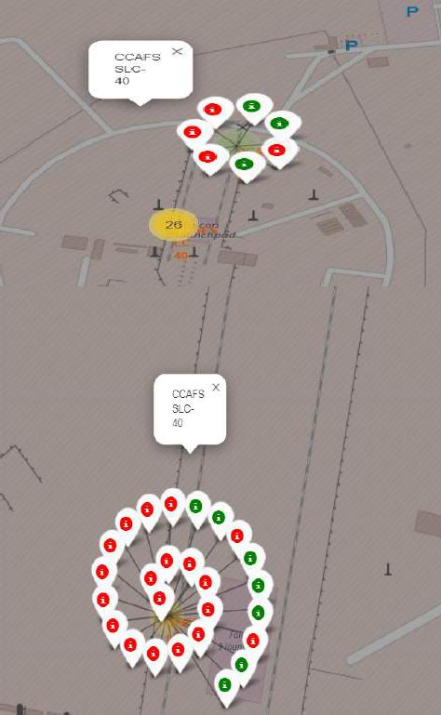
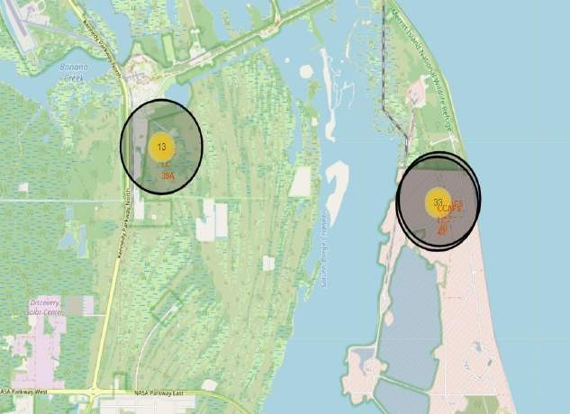
Markers showing launch sites with color labels
The green markers on the map indicate successful landings, whereas the red markers denote unsuccessful landings.

Slide 37

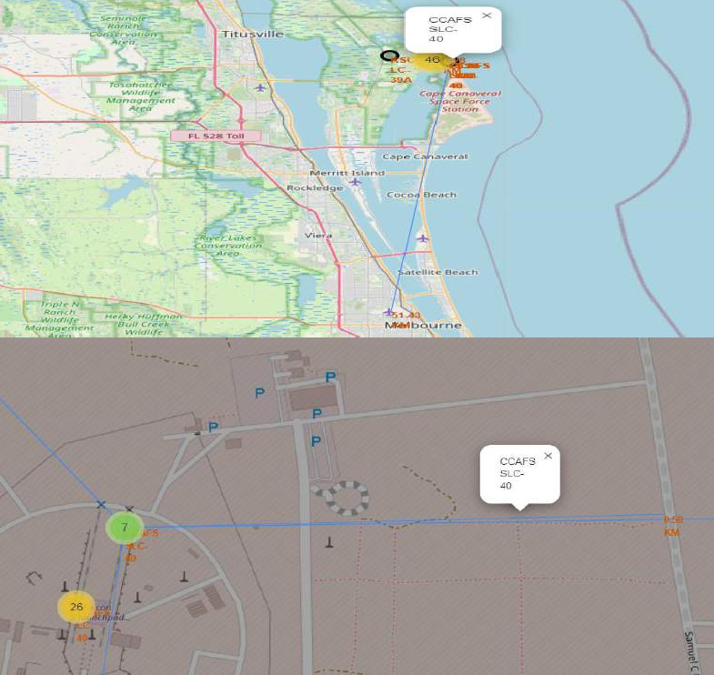

Launch Site distance to landmarks
Distance to closest City
Distance to Coastline
Distance to closest Highway
Distance to closest Railroad

Slide 38

Section 4

Slide 39
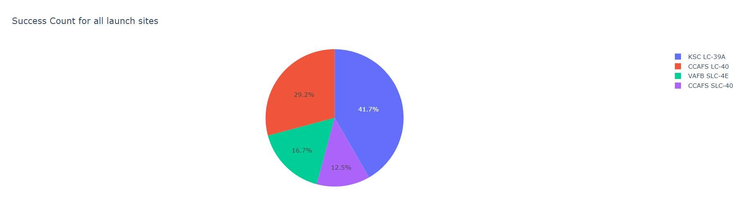
Pie chart showing the success percentage achieved by all Launch Sites
The pie chart illustrates that the launch site KSC LC-39A has the highest number of successful launches, while launch site CCAFS SLC-40 has the fewest successful launches.

Slide 40
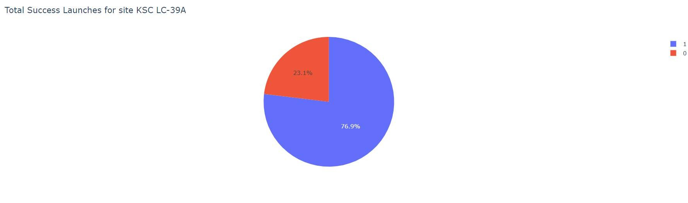
Pie chart showing the Launch site with the highest launch success ratio
Launch site KSC LC-39A achieved the highest success rate among all launch sites, with a success rate of x% and a failure rate of y%.

Slide 41

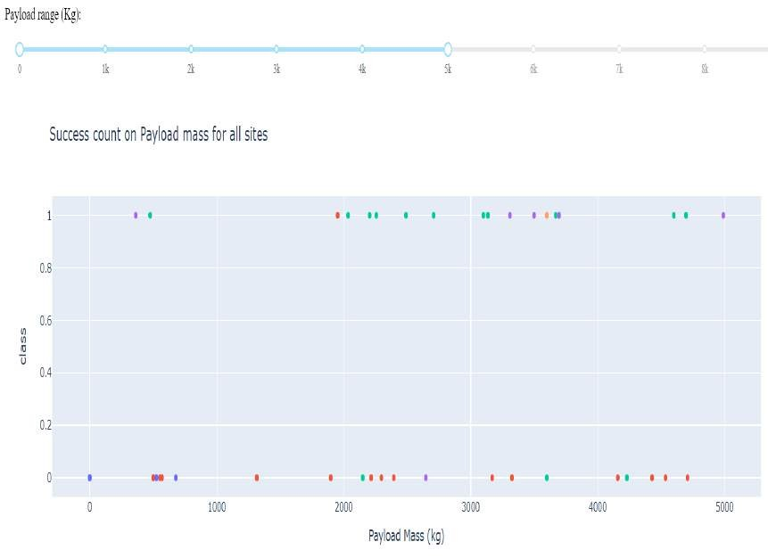
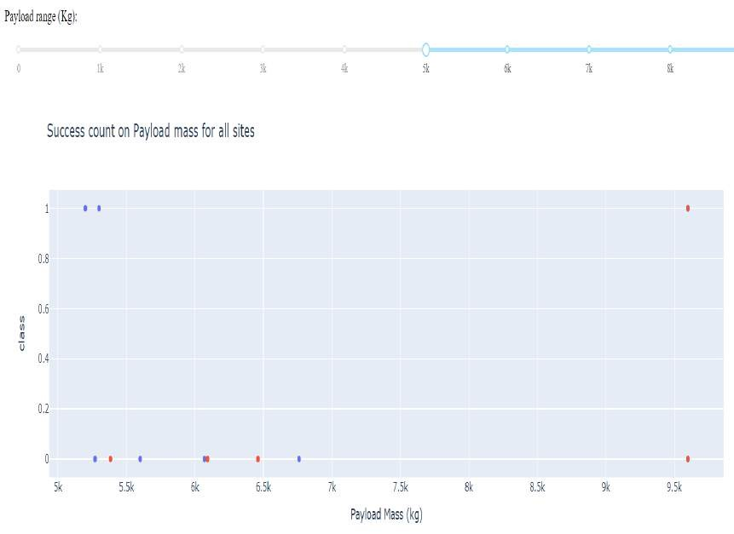
Scatter plot of Payload vs Launch Outcome for all sites, with different payload selected in the range slider
Low weighted Payload (0-5000)kg Heavy weighted Payload (5000-10000)kg
The Success rate for Low weighted Payload is higher as compared to High weighted Payload.

Slide 42

Section 5

Slide 43

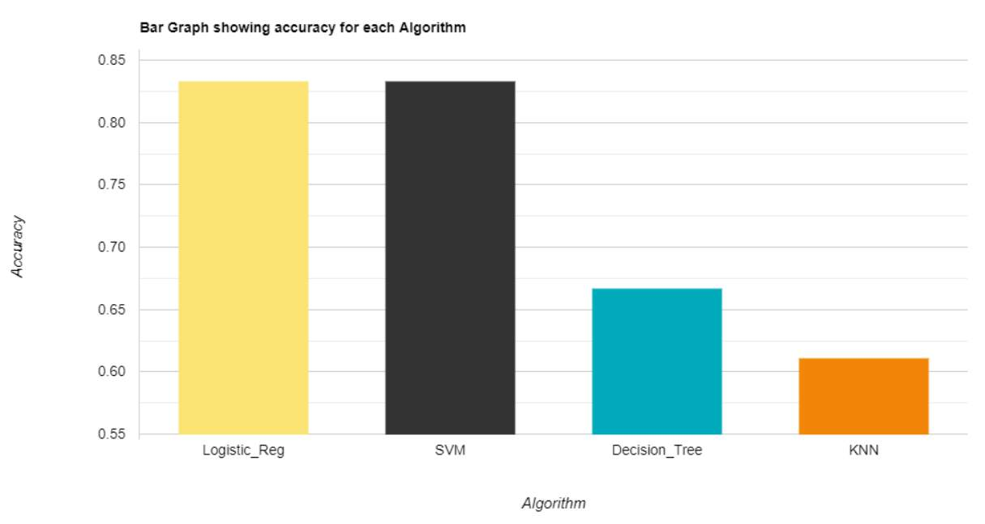
Classification Accuracy
From the bar chart observation, it's evident that the logistic regression model exhibits the highest accuracy (0.833), while the k-nearest neighbors (KNN) model demonstrates the lowest accuracy(0.611).

Slide 44

Confusion Matrix
The confusion matrix for the logistic regression model indicates that the model effectively distinguishes between different classes.
However, a notable issue lies in false positives, where unsuccessful landings are incorrectly classified as successful by the model.

Slide 45
Conclusions
Heavy Payloads are associated with higher frequency of successful landings.
Orbits ES-L1, GEO, HEO and SSO demonstrate the highest success rates.
There is a Positive correlation between the number of flights conducted at a launch site and the success rate of launches at that site.
The success rate has been on a steady rise since 2013, with the exception of a noticeable drop in 2018.
The first successful landing on a ground pad occurred on December 22, 2015.
The launch site KSC LC-39A has the highest number of successful launches, while launch
site CCAFS SLC-40 has the fewest successful launches.
Logistic Regression is the best machine learning algorithm for this task.
KNN model demonstrates the lowest accuracy for this task.
Other companies could use these factors to compete with SpaceX.

Slide 46
Appendix
All the codes are available on my GitHub: https://github.com/Steshitaya28/SpaceX-Applied-Data-Science-Capstone

Slide 47


